Slide 1
Finishing the Return
Pub 4012 – Tab K
Pub 4491 – Lesson 30
Notes:
Slide V2 changes:
#5 – Added savings bond purchase bullet
#9 – Reworded last sentence

Slide 2
Consents and Questions in Intake Booklet
Consent to Relational Office (Group) form
Affects how you finish the return
Taxpayer (and spouse if MFJ) gives consent
Can e-file federal and state
Taxpayer (and spouse if MFJ) do not consent return
Both federal and state must be paper filed
Notes:
2018 screen shot of consent will be added when available

Slide 3
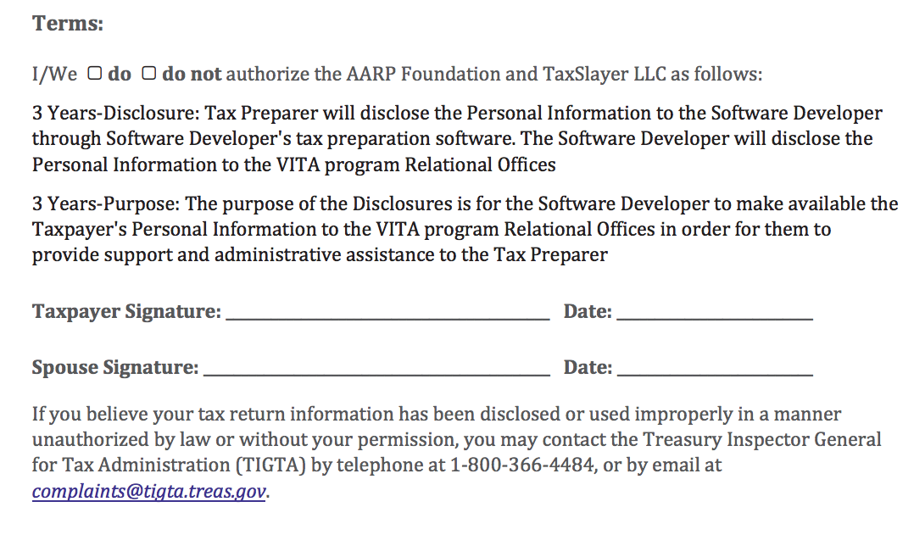
Consent to Relational Office (Group)
Return can be prepared with assumption of consent by absent spouse
Consent can be taken home for signature with Form 8879
Consent – signed by both taxpayer and spouse – must be presented prior to E-filing return

Slide 4
Consents and Questions in Intake Booklet
Other consent forms for 2018 included in Intake Booklet do not affect E-file
Global carryforward
Free information from AARP Foundation
Enter taxpayer responses to consents and questions included in 2018 Intake Booklet
Notes:
2018 screen shot of consent will be added when available

Slide 5
E-File Process
Pub 4012 Tab K
Six steps:
Return type
State return
Taxpayer bank account information
Savings Bond purchase information if selected
Third party Designee – never a Tax-Aide volunteer
Consents
Questions
State ID (if required)
Refer to Pub 4012 Tab K for TaxSlayer entries

Slide 6
E-file Not Possible
Use Paper Returns when E-file is not possible
Taxpayer does not consent on the Relational Office (Group) form
IRS directed taxpayer to file paper return
E-file attempt is unsuccessful
Reject cannot be resolved (e.g. identity theft, dependent claimed by someone else, etc.)
Notes:
Relational EFIN is consent #2. Without consent, must file paper return

Slide 7
Return Type - Overpayment
Taxpayers with refund: designate federal return type
E-filed
Paper check mailed to taxpayer
Directly deposited refund
Paper return
Taxpayer mails return and directly deposited refund
Taxpayer mails return with paper check mailed to taxpayer
Notes:
Taxpayer decides efile return type

Slide 8
Apply Refund to Next Year
Option to apply refund to next year’s estimated tax payments
Reduced if IRS offsets or makes adjustment
Entered in Payments and Estimate section of TaxSlayer
Notes:
• TS Navigation: Federal>Payments and Estimates>Apply overpayments to next year’s estimated payments

Slide 9
Return Type – Balance Due
Taxpayers with balance due: designate federal return type
E-file return
Payment by mail or online
Direct debit
Paper return
Taxpayer mails return with payment or taxpayer pays online
Notes:
Taxpayer determines return type

Slide 10
State Return
Select state return type
Without consent to Relational Office (Group) state return cannot be e-filed
Otherwise taxpayer chooses state options – can differ from federal
Notes:
State specific information placed here

Slide 11
Taxpayer Bank Information
Direct deposit or direct debit bank information
Enter bank name
Routing and account numbers must be entered twice for verification
Do not copy and paste
Do not enter bank routing number from deposit slip
Enter bank routing and account numbers from check
Absent a check, see Local Coordinator for other acceptable options
Notes:
Deposit slips often use different routing numbers. Always verify bank numbers. Split refund option may be available depending on site set up.
Check could be viewed on phone. May have other bank documents; often taxpayers carry card from bank with routing and account number written in. See Site Coordinator for acceptable alternatives

Slide 12
Taxpayer Bank Information
Savings bond purchase available from split refund screen when Form 8888 enabled
Purchased in $50 increments
Limited to three bonds
Fixed rate interest plus semiannual inflation
Total bond purchase limited to lesser of $5,000 or refund amount
Local Coordinator will advise if Form 8888 is set up for your site
Notes:
Low interest rate. Rarely purchased.
Taxpayers receive bonds by mail and remaining refund paid by check from IRS.
12

Slide 13
State ID
Pub 4012 Tab K
If state return prepared enter ID type
State driver’s license or ID
If no state ID available possible work around depending on state
Your Local Coordinator will advise if state ID information is required

Slide 14
Submission Screen
Can print a pdf to confirm all looks good
Do not print hard copy until review has been completed
Follow procedures for your site
Return is Complete – usually done by the reviewer
Review/Retransmit Status – “Ready for review”
Return Tag(s) per your site procedures

Slide 15
Finishing the Return

